Slide 1
Absolute Monarchies

Slide 2
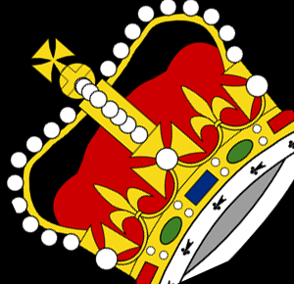
Absolute Monarchies
Most countries with monarchies have them as constitutional monarchies.
Only 5 countries in world have absolute monarchy
Brunei
Oman
Swaziland
Saudi Arabia
Vatican City

Slide 3
Absolute monarchies
Monarch has absolute control over his people.
Absolute monarchs often hereditary
Often have political groups that they can disband at will.

Slide 4
Example: Saudi Arabia
Executive Branch: Has a King’s Cabinet: 22 Minsters that he appoints
In 2009 Secretary of Education was the first woman ever appointed.

Slide 5
Example: Saudi Arabia
Legislative Branch: Consultative Council
appointed by King to advise the king
150 members for 4 year renewable terms
In 2003 Council announced intentions for 1/3 of Council to be elected, but no elections have taken place yet.
2013 30 women were appointed to the council.

Slide 6
Example: Saudi Arabia
Judicial Branch: Supreme Council of Justice
Use religious courts with justices appointed by the King.
King acts as the highest court of appeal and has the power to pardon.
Governed by Islamic Law
What is this called?

