Slide 1
The Other 17….
What have we needed to change in our government?

Slide 2
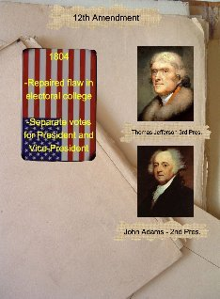
The Other 17…
11th Amendment
1794
Sovereign Immunity-People from out of state or foreigners cannot sue a state
12th Amendment
1804
Separate elections for president and vice president
What was used before?

Slide 3
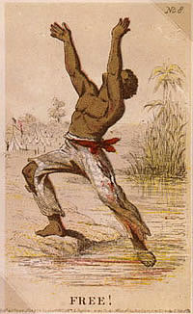
The Other 17…
13th Amendment
1865
No more slavery
14th Amendment
1868
Everyone regardless of race is guaranteed due process and equal protection under the law.
15th Amendment
1870
Prohibits denials of suffrage based on “race, color, or previous condition of servitude”.
Who would be upset by this?

Slide 4
The Other 17…
16th Amendment
1913
Federal Government can collect Income Tax
17th Amendment
1913
Direct Election of Senators
What was used before this?

Slide 5
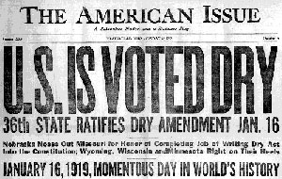
The Other 17….
18th Amendment
1919
Alcohol Illegal (starts prohibition)
19th Amendment
1920
Women’s Right to Vote

Slide 6
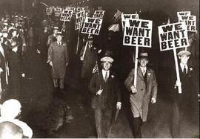
The Other 17…
20th Amendment
1933
Terms for Congress start January 3rd…President is January 20th
21st Amendment
1933
Repeals Prohibition
22nd Amendment
1951
Limits the president to two terms

Slide 7
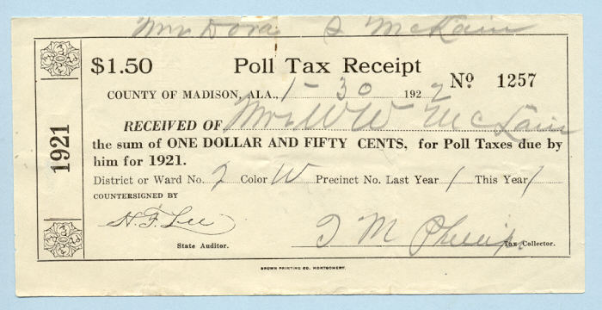
The Other 17…
23rd Amendment
1961
DC can vote in presidential elections
24th Amendment
1964
No more poll taxes to vote
25th Amendment
1967
The VP takes over if the president dies

Slide 8
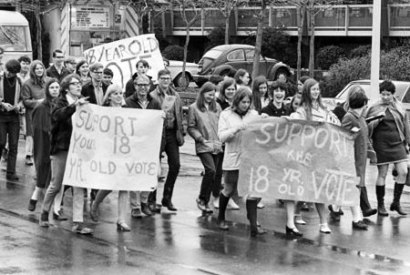
The Other 17…
26th Amendment
1971
Voting at 18!
27th Amendment
1992
Pay raises for Congress can’t take effect until next term

