Slide 1
The Government that Failed The Articles of Confederation
1776-1787

Slide 2
The Phrase to Remember!
The Articles of Confederation sucked because the feds were too weak!

Slide 3
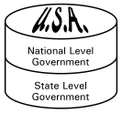
What is Federalism?
Split between national and state/local government.
Needs to have at least two layers of government.
Also have a confederal system and a unitary system.

Slide 4
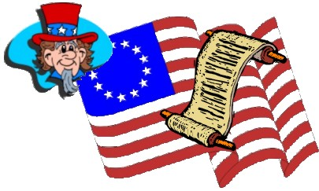
What is Federalism?
Federalism
Strong central government with smaller subgovernments that make lesser decisions.
What states would want this?
Unitary
A strong central government where all of the power resides.
What states would have this?
Confederal
Subgovernments have the most power.
Central government is weaker like under Articles of Confederation.
Any modern day examples?

Slide 5
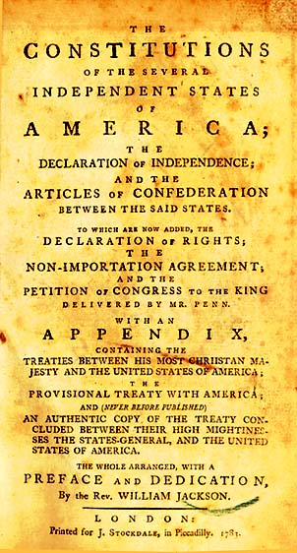
Strong State Governments
Established a government dominated by states.
Established 1781 two years before the Revolutionary War finished.
A “league of friendship and perpetual union between states”
Why would they not want a strong national government?

Slide 6
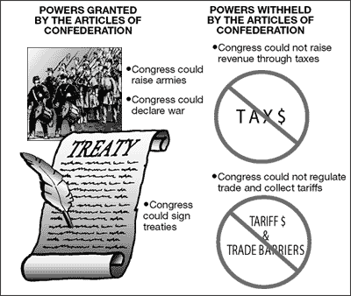
Power of the Articles
A unicameral house.
Each state had only one vote
No president and no national court.
Powers of national legislature limited.
Most authority held in state legislatures.

Slide 7
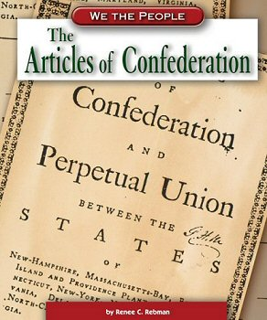
Weaknesses of the Articles
Had few powers outside of maintaining an army and navy.
Had to request money from states-no power to tax.
States often refused to send money.
Could not regulate commerce.

Slide 8
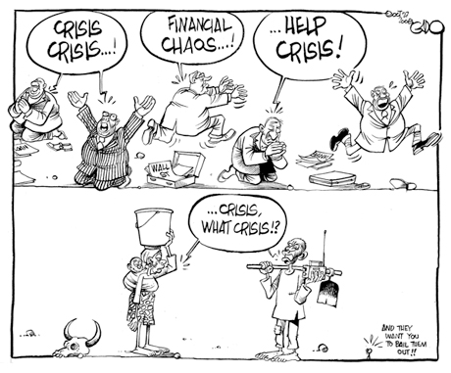
Economic Turmoil
Postwar depression left many farmers unable to pay debts.
Some states printed tons of money and passed “force acts” that required creditors to accept worthless money.
States printed their own money.
Had tariffs between states.

Slide 9
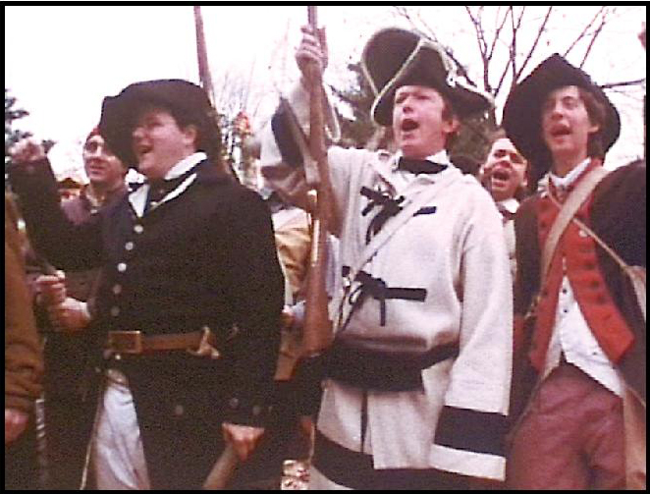
Shay’s Rebellion
Small band of farmers in Massachusetts rebelled at losing land to creditors.
Led by Daniel Shay
Congress and state could not raise army to stop rebellions.

Slide 10
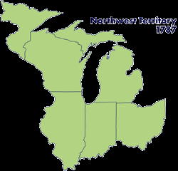
Some Strengths
Established Northwest Ordinance of 1787.
Encouraged development of Great Lakes region.
Gave tips on what to avoid in Constitution.

