Slide 1
Communism
Beliefs and Origins

Slide 2
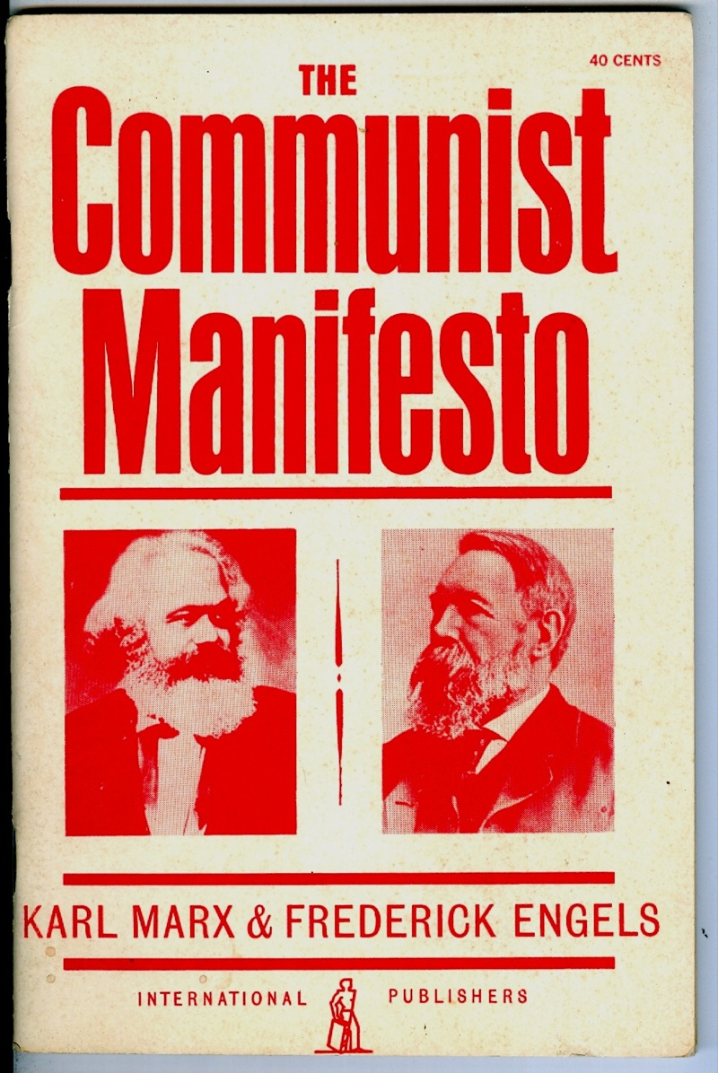
The Communist Manifesto
Karl Marx and Frederic Engles-1848-German authors
Came as response to Industrial Revolution and capitalism it brought.
Why would this be?
Called for “Workers of the world to unite and overthrow the world of the rich”

Slide 3
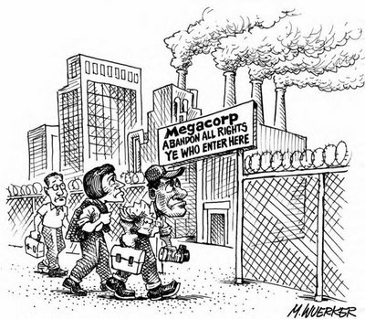
Communist Manifesto
Saw entire history as struggles between the “have nots” (proletariat) and the “haves” (bourgeoisie)
Employers benefitting from work of laborers-workers not seeing any benefits.
Rich getting richer while poor get poorer.

Slide 4
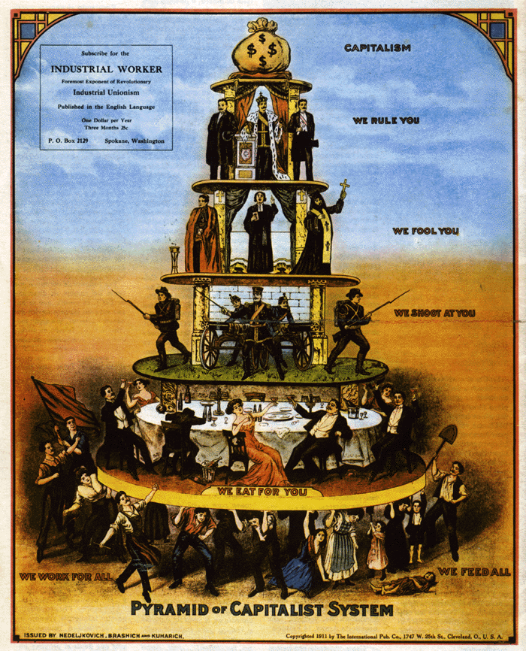

Slide 5
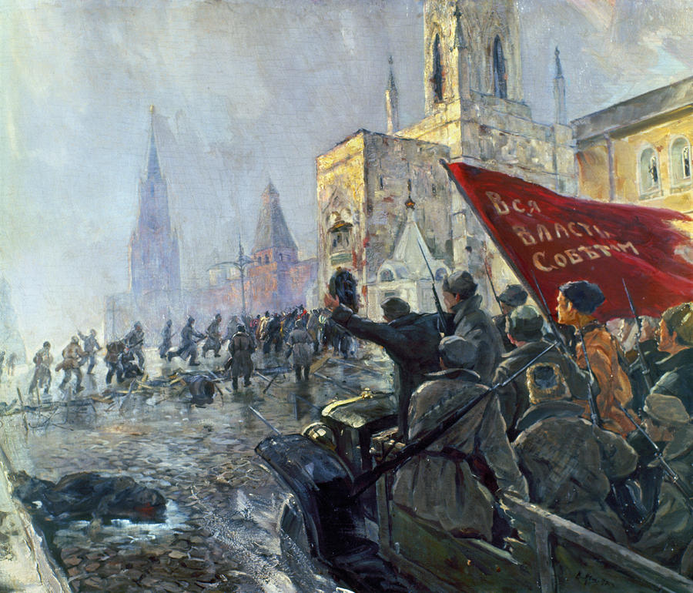
Communist Revolution
Revolution needs to come
Proletariat will overthrow bourgeoisie
Wealth redistributed
Classes and private property would no longer exist
Goal-To Make Everyone Equal so that no conflicts would exist. (Gov’t not needed)
Why is this a problem?

Slide 6
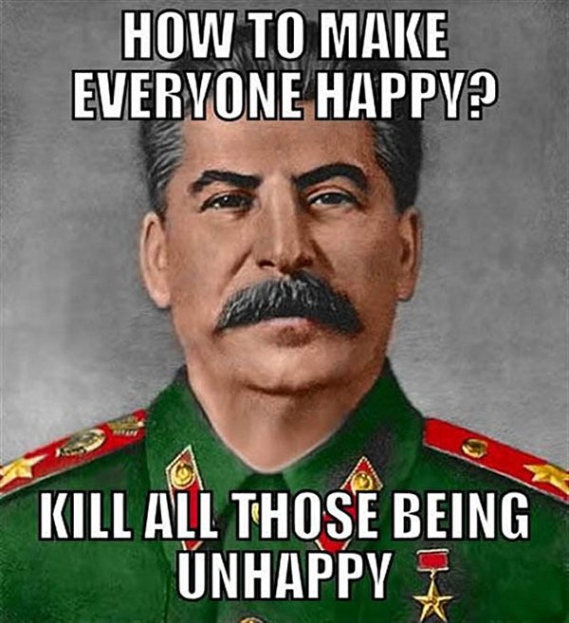
Socialism vs. Communism
Communism (Authoritarianism)
Gov’t owns all of economy-no private property
Violent Revolution
No human rights
No elections
USSR or China under Mao

Slide 7
Socialism vs. Communism
Socialism (democratic)
Gov’t owns part of economy-private property is allowed
No need for violent revolution
Human Rights and Liberties guaranteed
Elections for leaders
Norway, Sweden, Finland, France (many European countries)
Higher taxes, more gov’t services, free health care, free higher education, Extensive welfare if no job
It’s a spectrum

Slide 8
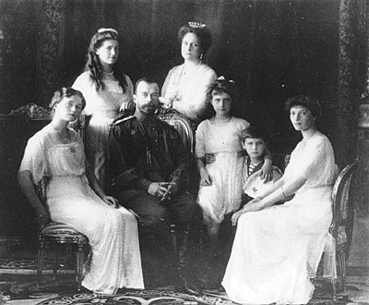
1917 Russian Revolution
Overthrew czar and family
USSR-Union of Soviet Socialist Republics
Communism is philosophy-not a government-needs government to carry out communism
How could this be a problem?

Slide 9
Communist Conflicts
Entered into Cold War between USSR and US 1945-1991
USSR discouraged religion
Why?
“One nation under God” added to Pledge of Allegiance.
Also brought McCarthyism

Slide 10
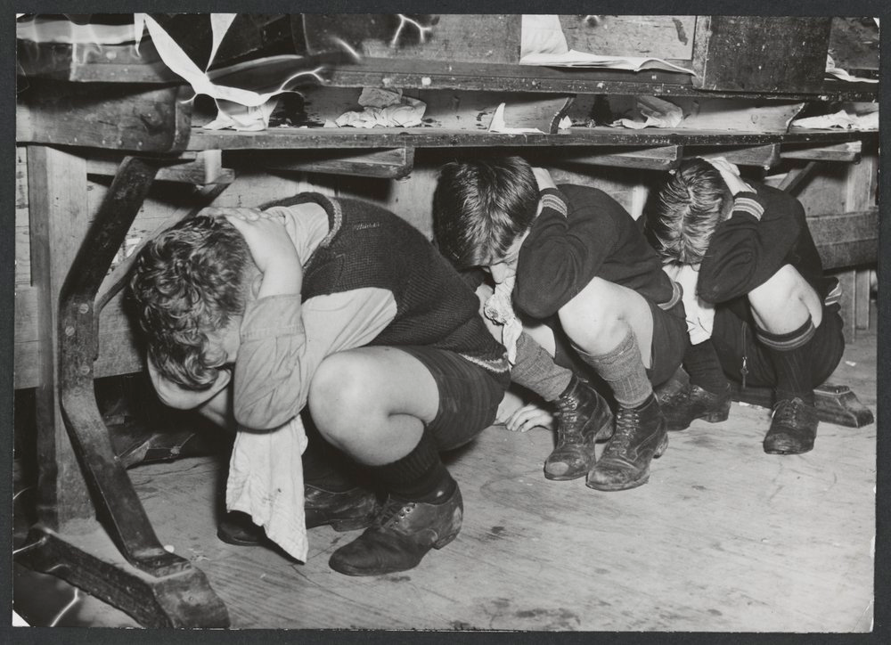
Communist Conflicts and Cold War
Competition between US and USSR
Had weapons buildup
Became “mutually assured destruction”
Attack drills in schools

Slide 11
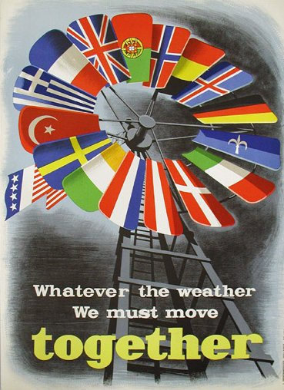
Communist Conflicts and Cold War
Marshall Plan
Help countries to stop spread of communism
Led to “containment theory”
Vietnam and Korean War

Slide 12
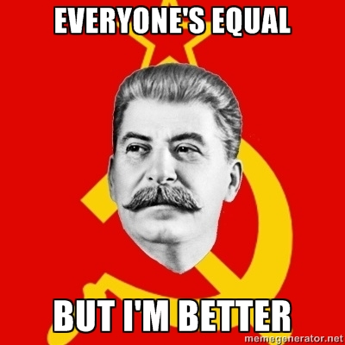
Main Points
History is a history of class struggle between rich and poor
Capitalism leads to two classes, the bourgeosie and the proletariat.
Trend - Capitalists gain wealth while workers sent deeper into poverty
Violent revolution inevitable -- Workers have nothing to lose
“Dictatorship of Proletariat” = Period where people are educated to work cooperatively
Eventually government disappears. . .
Classless society = Communism

Slide 13
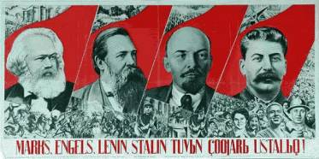
Marxism vs. Authoritarian Communism
Government never disappeared in Russia or China
Believed in basic human rights – people give voluntarily (AFTER dictatorship of proletariat)
Classless society – all equal / Never happened in USSR or China which had privileged elites running govt.

