Slide 1
Parliament vs. Presidential Systems
Mini-Unit 1
Government Systems Unit

Slide 2
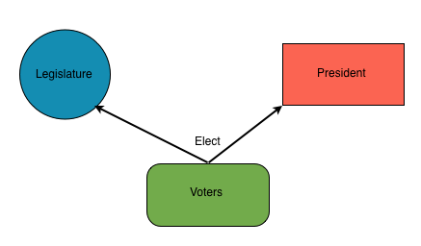
Presidential System
President elected every 4 years by electoral college
Based on popular vote
Elected as president (separate from Congress)
Could have gridlock in Congress
Why?

Slide 3
Presidential System
Cabinet members usually not from Congress.
Expertise in policy area gets them appointed to Cabinet.

Slide 4
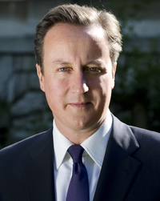
Parliamentary Systems
Serves only as long as she/he remains leader of majority party.
Elected as member of Parliament.
Has great chance of getting programs passed in parliament without gridlock.
Why?

Slide 5
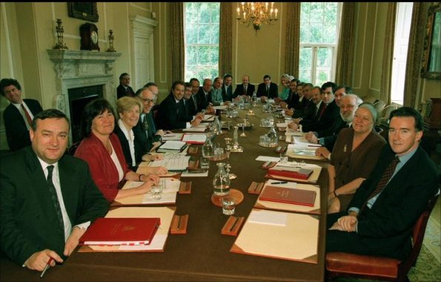
Parliamentary Systems
Cabinet members are always MPs and leaders of majority party.
Cabinet members not experts in policy
This is a job of the bureaucracy.

Slide 6
Showdown -Elections
Parliament-Elections take place every 5 years and all members of parliament face re-election.
Presidential-Elections take place at a set point every 4 years and not all members of Congress face reelection.
What are the plusses and minuses of each?

Slide 7
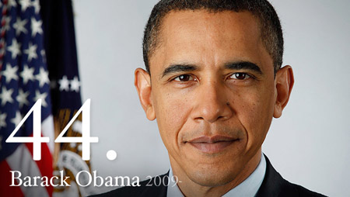
Showdown-Party Membership
Parliamentary-Prime Minister part of majority party so very cohesive.
Presidential-President elected separately so could have gridlock.
Plusses and minuses of both?

Slide 8
Showdown-Out of Office
Parliamentary-If Parliament not content with PM-can vote him down before end of term with a “vote of no confidence”
Presidential-If legislature upset with president, need to wait 4 years until next election.
Plusses and minuses of both?

Slide 9
Showdown-Term Limits
Parliamentary-Prime minister can stay in power for as long as party has majority and wants him/her in office.
Presidential-President limited to two four-year terms.
Plusses and minuses of each?

