Slide 1
The Bill of Rights
These are your Rights!!
1789

Slide 2
The Big One
1st Amendment
Freedom of press, speech, assembly, petition, and religion
Religion-establishment clause (Separation of church and state)
Religion-free exercise clause

Slide 3
The Bill of Rights
2nd Amendment
Right to Bear Arms
3rd Amendment
Quartering Soldiers Not Allowed
4th Amendment
Protection against search and seizure

Slide 4
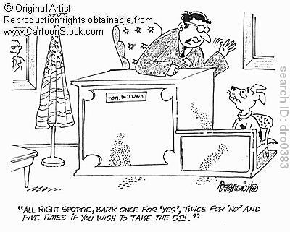
The Bill of Rights
5th Amendment
“Plead the 5th” (Cannot incriminate yourself)
Due Process-State must respect all legal rights owed to a person
Double Jeopardy-Cannot be tried for the same crime twice

Slide 5
The Bill of Rights
6th Amendment
Right to fair and speedy public trial
Right to an attorney
7th Amendment
Right to trial by jury
Miranda Rights
Must be made aware of your rights when arrested

Slide 6
The Bill of Rights
8th Amendment
Protection Against Cruel and Unusual Punishment
9th Amendment
Implied rights-rights can’t be denied that aren’t in the Constitution
10th Amendment
Anything not in the Constitution is left up to the states
Any examples?

