Slide 1
Article II
The Presidency

Slide 2
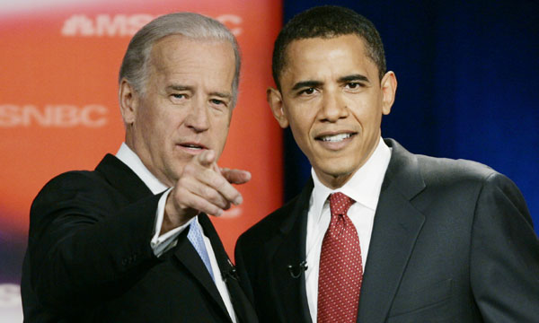
Section 1:President and VP
Clause 1-Vesting Power
There is a president and VP
Holds office for 4 years.

Slide 3
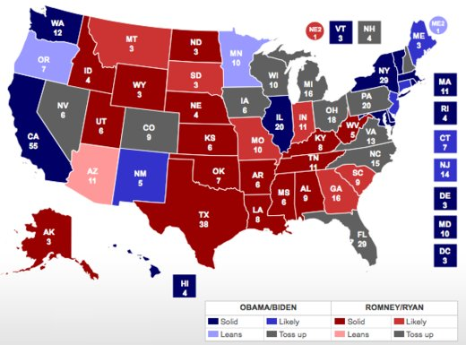
Section 1: President and VP
Electors
Each state appoints electors=House and Senate.
Cannot be in Congress
Meet in their home state capitol.

Slide 4
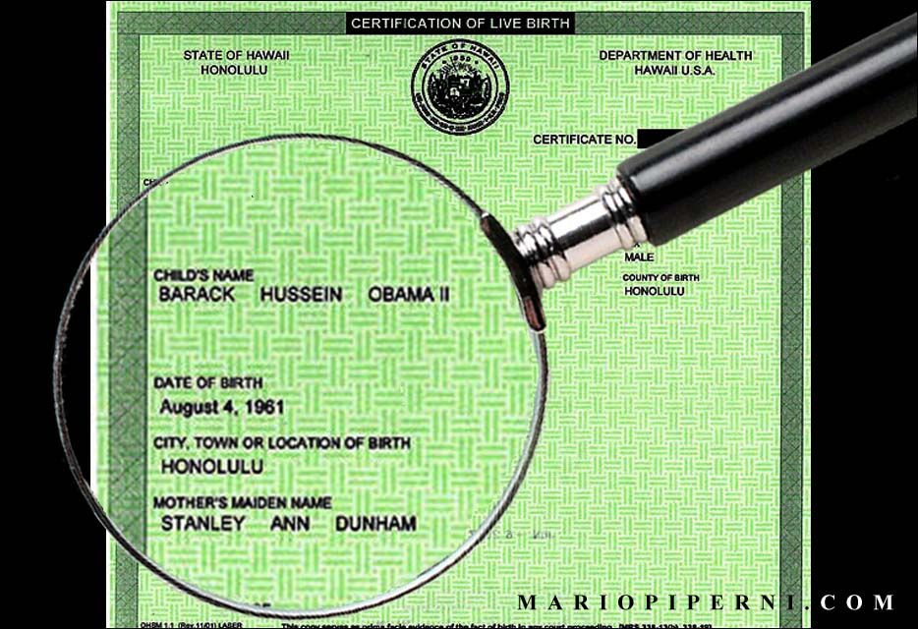
Section 1: President and VP
Qualifications
Natural born citizen or citizen when Constitution adopted.
35 years old
14 years a resident

Slide 5
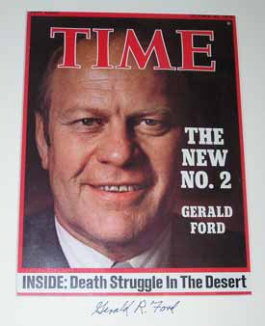
Section 1: President and VP
Vacancy and Disability
Congress decides who takes over until new person elected.
25th amendment in 1967 made it so the vice president would always take over.

Slide 6
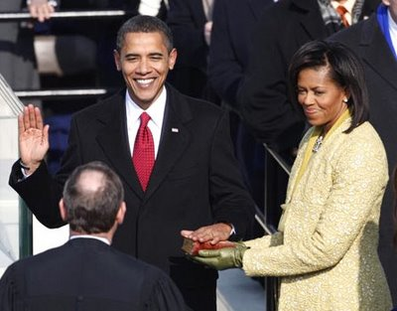
Section 1: The President and VP
The Oath:
"I do solemnly swear (or affirm) that I will faithfully execute the Office of President of the United States, and will to the best of my Ability, preserve, protect and defend the Constitution of the United States."

Slide 7
Section 2: Presidential Powers
Clause 1:
Commander of the military.
Clause 2: Advise and Consent
Can nominates judges, ambassadors, and heads.
Can make treaties

Slide 8
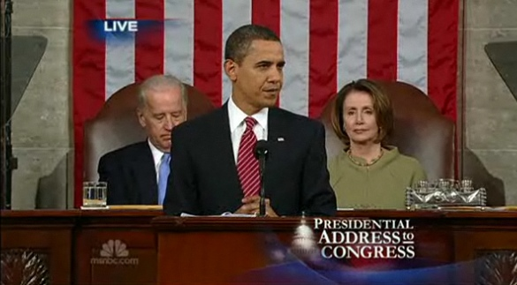
Section 3: Presidential Responsibilities
Clause 1: State of the Union
Gives State of the Union “from time to time”
Clause 2: Recommendations
Make recommendations to Congress that is “necessary and expedient”

Slide 9
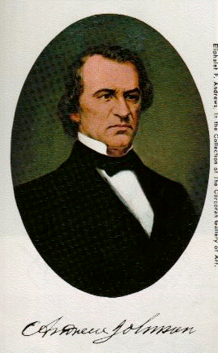
Section 4: Impeachments
President, Vice President, and civil Officers can be impeached
“For and conviction of treason, bribery, and other high crimes and misdemeanors”
Impeached by House and tried by Senate

