Slide 1
Article III
The Judiciary

Slide 2
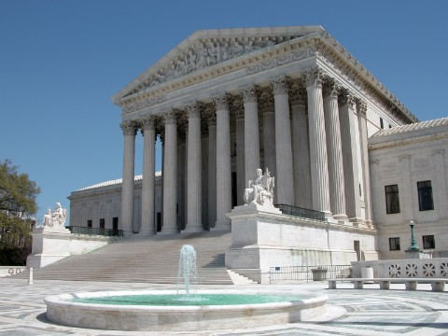
Section 1: Federal Courts
Judicial power is in federal courts
Must have a supreme court
Does not give a specific number of justices
9 today

Slide 3
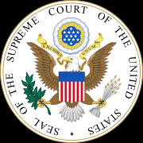
Section 1: Federal Courts
Tenure
“May hold office during good behavior”
No age requirements or other requirements
Salaries
Salaries may be increased but not decreased.

Slide 4
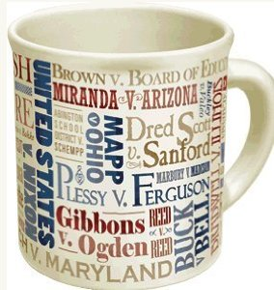
Section 2: Judicial Power
Cases and Controversies
Only actual cases may be heard by the Supreme Court.
Why is this important?
Can choose which cases they want to hear for term.
Only hear about 100 cases and about 70-90% get turned away each year.

Slide 5
Section 2: Judicial Power
Judicial Review
Set by Marbury v. Madison in 1803
Review of law to determine if it is Constitutional.

Slide 6
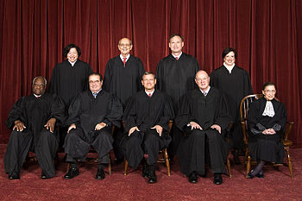
General Supreme Court Information
Chief Justice John Roberts
All have been lawyers
Typically all white male protestants.
Appointed by president and confirmed by Senate with 51 votes.
Many plan out retirement because of this. Why?

Slide 7
General Supreme Court Information
This is a court of appeals
No trials
No jury
No witness
Only hear arguments and read briefs from lawyers

