Slide 1
Article IV-VII
The Constitution

Slide 2
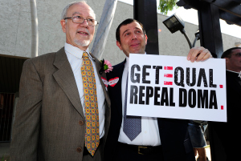
Article IV
Full Faith and Credit
Gives “full faith and credit” to what every other state does.
Example-marriage (Except for DOMA)
Privileges and Immunities
Cannot discriminate people from other states.
Have to respect all laws of the state you are in.
Extradition of Fugitives
A criminal who flees must be given over to the other state.

Slide 3
Article IV
New States
Congress admits new states to the Union.
No state can be formed by joining multiple states.

Slide 4
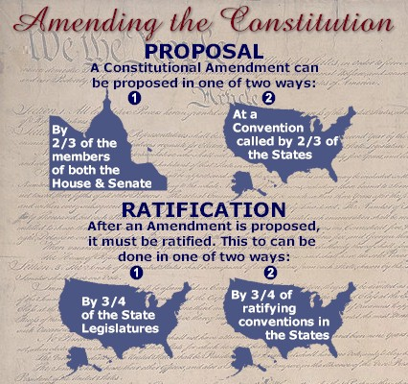
Article V
Amending the Constitution
PROPOSED by EITHER
2/3 of both House and Senate
National convention proposed by 2/3 of states.
RATIFIED by EITHER
Legislatures of ¾ of states.
State ratifying conventions in ¾ of states.

Slide 5
Article VI
Federal laws and treaties the supreme law of the land.
No religious test to hold government office.
US is responsible for paying their debts.

Slide 6
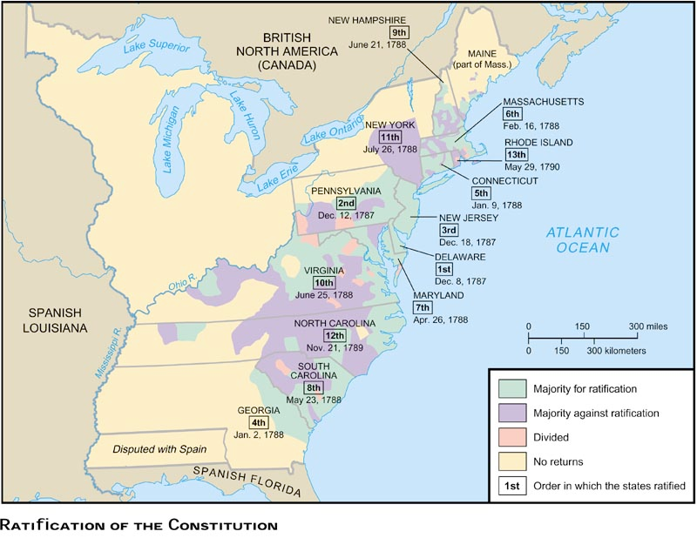
Article VII
Ratifications necessary for Constitution to take effect.
9 out of 13
Delaware was first to ratify.
Federalists wanted to ratify (wealthy landowners and businessmen, James Madison, Alexander Hamilton)
Antifederalists wanted more freedom (farmers, smaller government-Sam Adams, Thomas Jefferson)
Led to compromise of Bill of Rights.

