Slide 1
What Did the Founders Think About Constitutional Government?
Unit 1 Section 1

Slide 2
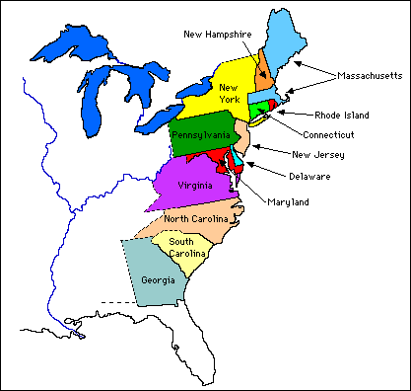
Characteristics of Colonial America
Free in 1783 with Treaty of Paris
Separation
Physical distance
Religion and language
Class Differences
Wealthy families dominated
Farming
Different things for different places.
Slavery
300,000 slaves in 1760

Slide 3
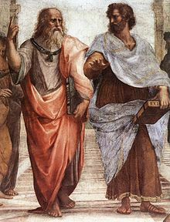
How Did Founders Learn About Government?
.
Aristotle and Cicero of Greece
16th and 17th Century Hobbes and Locke
By 1776 had 150 years of local self-government

Slide 4
What Did the Founders Learn about Government?
Sources contradicted each other
Ancient philosophers
People had obligations to one another
Those who govern must be wise.
Help people learn
Greek and Roman
Democracy begins well but ends in tyranny.
Natural rights theorists
People have natural rights that must be respected.
Form government to protect rights.
British
Monarchy could evolve into free government.
American
Local self-government coexist with distant central authority.

Slide 5
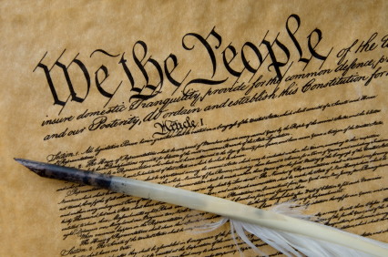
What Did the Founders Learn about Government?
Government should be servant, not master of people.
Fundamental higher law, or constitution, should limit government.
.

Slide 6
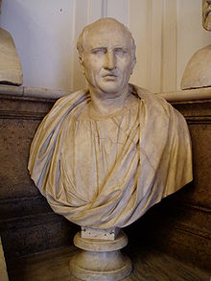
From What Could the Founders Choose?
Mixed Constitution
Mix of monarchical, aristocratic, and democratic.
Britain
Limit of monarch, aristocracy in House of Lords, House of Commons for common people.
Representative government
Republic-Thing of the people.
Representatives in gov.
Did not like direct democracy
Why?
.

Slide 7
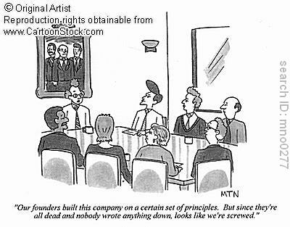
What is a Constitution?
Plan that sets forth the structure and powers of government.
Controversies around written constitutions
Why?
Unwritten constitutions
Only Britain, Israel, New Zealand.
Combo of written laws and precedents.

Slide 8
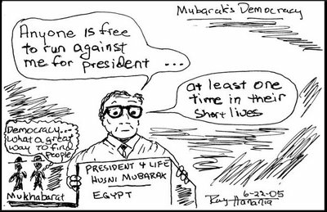
What is a Constitution?
Constitutional government= limited government.
Government limited by provisions of constitution.
Democracies have free, fair, regular elections.
Unlimited government where rulers use power, unrestrained by laws or elections.

Slide 9
Discussion Questions
1. How would you organize a government so that it would be fairly easy to remove and replace officials who violated the constitutional limitations on their powers?
2. What might happen in a government in which there as no agreed-on or peaceful means for removing officials? Give a recent example to support your answer.
3. Is it important that a constitution be written? What are the advantages and disadvantages of a written constitution? Of an unwritten constitution?

Slide 10
Cool Down Day 1
How would America be different if we had direct democracy as opposed to an indirect republic/representative democracy?
3 sentences

