Slide 1
What Ideas About Civic Life Informed the Founding Generation?
Unit 1 Section 2

Slide 2
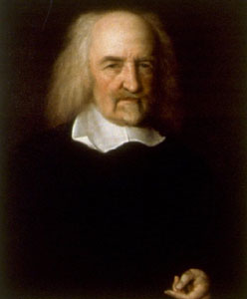
What Values from Natural Rights Philosophy Influenced the Founding Generation?
17th Century period of Enlightenment
Hobbes and Locke gave politics fresh start.
Hobbes
State of nature gives rise to “war of every man against every man”
Man is by nature bad and selfish.
Chaos make people enter into a social contract.

Slide 3
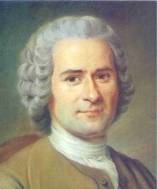
What Values from Natural Rights Philosophy Influenced the Founding Generation?
Rousseau
Man is by nature good.
Society around man is bad.
Society makes man bad.

Slide 4
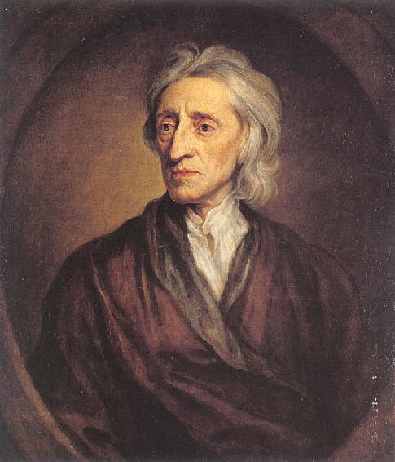
What Values from Natural Rights Philosophy Influenced the Founding Generations?
Locke
In state of nature all people free, equal, and rationale.
Each person has inalienable rights- “life, liberty, and estate”
Can punish those who don’t respect that.
Most people seek personal advantage in natural state and to secure rights enter into “social contract.”
Man is a blank slate and learns from society.

Slide 5
Natural Rights’ Influence
Individual Rights
Inalienable rights regardless wealth, social status, or birth.
First only saw themselves as having rights as subjects but then developed into Lockean rights
Personal, inherent, inalienable.
Popular Sovereignty/Gov by consent
Government gets authority from consent of people-popular sovereignty
Can withdraw consent since authority rests in their hands.
Thus natural rights include rights of revolution.

Slide 6
Natural Rights’ Influence
Limited Government
Government is to serve private ends-especially protection of life, liberty, and property.
Government reflects the needs of society and no further.
Human Equality
In state of nature all people free from one another’s control and equal to one another.
Inequalities like slavery existed in colonies.
Introduced in VA in 1619 and legal in every colony by 1776.
Women legally dependent on men.

