Slide 1
What Were the British Origins of American Constitutionalism
Unit 1 Section 4

Slide 2
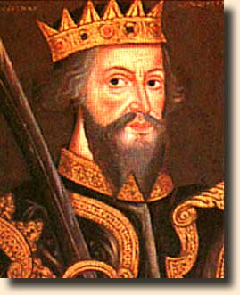
How Did the English Government Begin?
After fall of Rome England divided into tribes.
Eventually unified under 1 king but with local lords.
Why?
William the Conquerer-1066
Brought feudalism
Monarchs had advisors
By 13th cent. advisors developing separate institutions.
Evolved into Parliament and royal court.

Slide 3
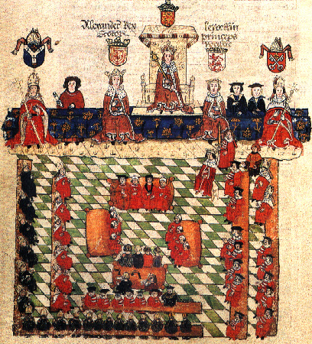
How Did Parliamentary Government in England Begin?
English monarchs had councils of advisors called parliament.
Parler= to speak
1295 King Edward I summoned Model Parliament.
House of Lords-nobility
House of commons-2 nights from each shire (county)
Crown found it effective way to raise money.

Slide 4
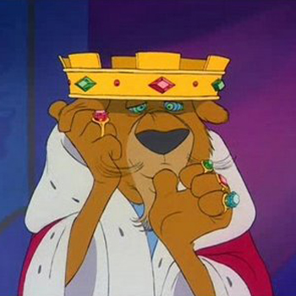
How did the “Rights of Englishmen” Develop?
In 1100 King Henry II issued Charter of Liberties-made him obey laws regarding treatment of nobles and clergy.
In 1215 King John forced to sign new Charter of Liberties-Magna Carta.
Addressed relationships between Crown and barons, clergy, and merchants.

Slide 5
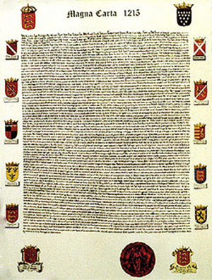
How did the “Rights of Englishmen” Develop?
3 basic principles of Magna Carta
Rule of Law- Monarch must respect law. Arbitrary gov outlawed.
Basic Rights-Goal to establish redress of grievances-compensation for loss or wrongdoing.
Government by Agreement-Drawing up an agreement for rule.

Slide 6
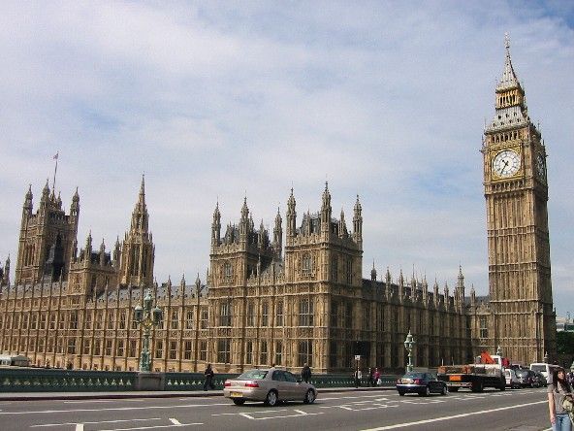
What is the British Constitution?
NOT A SINGLE DOCUMENT
Common law, acts of Parliament, political customs and traditions.
Basic principle is respect for rule of law.

Slide 7
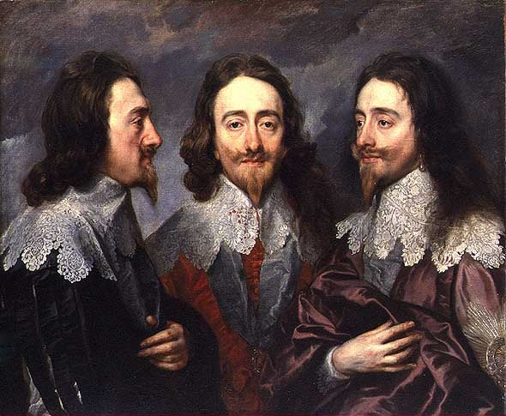
What is the British Constitution?
17th Century lots of struggles between parliament and monarchy.
Heart of issue: Did crown have to accept supremacy of laws made by parliament?
Petition of Rights (1628)
King Charles I needed $ to fight against France and Spain. Didn’t get consent.
Forced to sign Petition of Right-taxes not raised w/o parliament consent.
Also said citizens don’t need to quarter soldiers.
Right to habeus corpus.

Slide 8
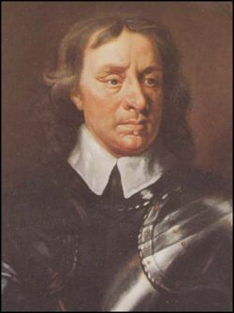
What is the British Constitution?
English monarchy fell in 1649 when Charles I executed.
Oliver Cromwell took over Commonwealth-then Charles II back in 1660.
Habeas Corpus Act of 1679
Confirmed right of British to apply for habeas corpus-person in custody has the right to know why he is being held and have a trial. If gov cannot justify the person must be set free.

Slide 9
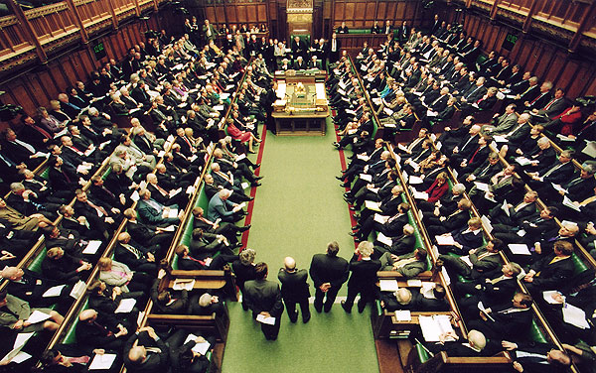
What is the British Constitution?
By 17th century parliament was the most powerful group in gov.
English Bill of Rights
Limitations on crown’s power to raise money.
Free speech and debate
Rule of law
Representative government

